Slide 1
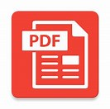





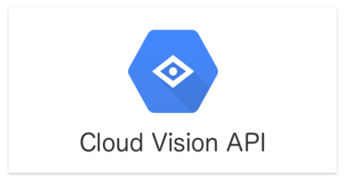


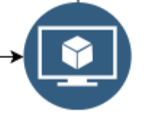


Architecture Logical Diagram
Research daily Financial report
Chatbot
Text / Voice
8. Request
Financial advice
12. Response today financial predictions
3. Upload PDF via API
Cloud Storage
11. Store / Retrieve
Result
Diaglogflow
Cloud Datastore
4. Trigger Cloud function
1. Labelled Data (Good/Bad comment)
9. Run
Application
(Python)
10. Generate
Predictions
with REST API
2. Supervised training data
5. Extract Text and convert format (using Python)
Cloud Machine learning
6. load formatted data
7. AutoML Natural Language search
Trained Model
Cloud Storage
Cloud AutoML

Slide 2

cloud datastore的圖片搜尋結果

